Slide 1

Scanning Networks
Presented by-
Farhana Akter Suci (B190305001)
Nusrat Alam Srabanti (B190305045)
Presented to-
Dr. Mohammed Nasir Uddin
Professor, Department of CSE , Jagannath University

Slide 2
Objectives
1
2
4
Network Scanning Concepts
Scanning techniques for host discovery
3
Scanning techniques for port and service discovery
Scanning techniques for OS discovery
5
Scanning beyond IDS and Firewall

Slide 3

Jagannath University
3

Slide 4

Network Scanning is
  Systematic method to identify devices and services in a network.
  Used by ethical hackers and security professionals.
  Helps assess network exposure and security weaknesses.
FIGURE 1. Network Scanning .
Jagannath University
4

Slide 5
Objectives Of Network Scanning
  Identify active hosts and devices on the network
  Discover open ports and running services
  Detect potential vulnerabilities and misconfigurations
  Map the network structure and topology
  Assess the overall security posture of the network
Jagannath University
5

Slide 6
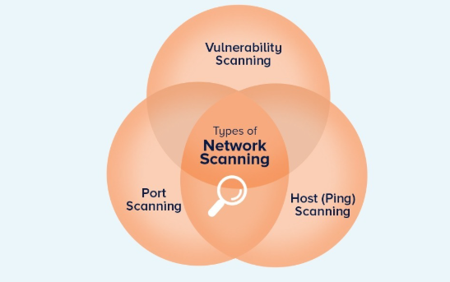
Types of Network Scanning
  Port Scanning: Identifies open ports on a system .
  Vulnerability Scanning : Detects known security weaknesses and misconfigurations.
  Ping Scanning: determine online/offline status of devices within a network
FIGURE 2. Types of network Scanning .
Jagannath University
6

Slide 7
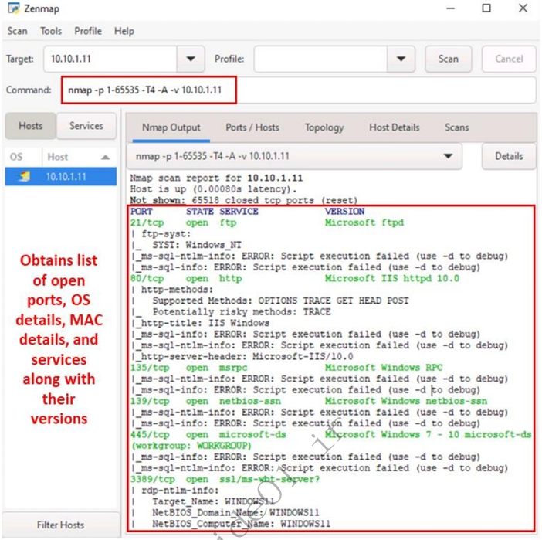
Nmap (Network Mapper):Used for network discovery, port scanning, and service identification.
Scanning Tools
FIGURE 1. Screenshot displaying Nmap scan resilts .
Jagannath University
8

Slide 8
Scanning Tools (Cont..)
Hping3:A packet-crafting tool used for advanced network testing and firewall analysis.
Metasploit:A security framework used to test vulnerabilities and validate security weaknesses.
NetScan Tools Pro:A Windows-based toolkit for network scanning, diagnostics, and security auditing.
Jagannath University
9

Slide 9

Jagannath University
10

Slide 10
Host discovery is
Process of identifying live (active) hosts in a network
Performed before detailed scanning
Used by ethical hackers and security professionals
Multiple techniques are applied since firewalls may block some methods
Jagannath University
11

Slide 11
Types Of Host Discovery
ARP Ping Scan:
Identifies live hosts in a local network using ARP requests.
UDP Ping Scan:
Detects active hosts by sending UDP packets and analyzing responses.
ICMP Ping Scan:
Uses ICMP echo requests to check host availability.
TCP Ping Scan:
Determines live hosts by sending TCP packets to common ports.
Jagannath University
12

Slide 12
Comparative Analysis of Host Discovery Techniques
Scan Type | When to Use | Best For | Limitations
ARP Ping Scan | When scanning within the same local network (LAN) | Most reliable LAN host discovery | Works only in local subnet
UDP Ping Scan | When ICMP/TCP is blocked but UDP allowed | Detecting hosts with UDP services | Slow, high false negatives
ICMP Ping Scan | Quick checks on open networks | Fast and simple discovery | Often blocked by firewalls
TCP Ping Scan | When ICMP is blocked but TCP allowed | Firewall-friendly discovery | Needs open TCP ports
Jagannath University
12

Slide 13
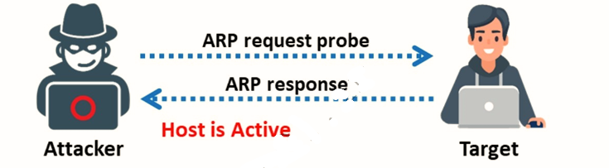
How ARP Ping Scan Works ?
Sends ARP request messages to IP addresses in the local network
Active devices reply with their MAC address
Devices that respond are identified as live hosts
Effective even when firewalls block ICMP or TCP scans
FIGURE 2. ARP ping Scan .
Jagannath University
13

Slide 14
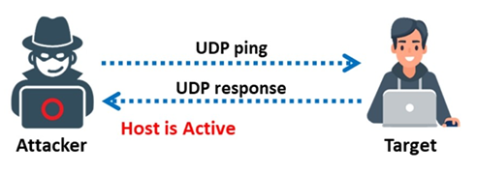
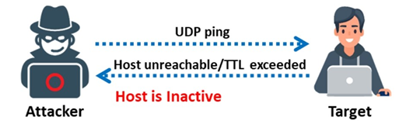
How UDP Ping Scan Works ?
Sends UDP packets to specific ports on target hosts.
If the host is active and the port is closed, it may reply with an ICMP “Port Unreachable” message
Receiving this response indicates the host is live
No response may mean the host is inactive, filtered, or the port is open
FIGURE 2. UDP ping scan to determine if the host is active .
FIGURE 3. UDP ping scan to determine if the host is offline .
Jagannath University
15

Slide 15
Host Discovery Traditional Scanning VS With AI
Traditional Scanning | AI‑Based Host Discovery
Rule‑based approach | Learns from network behavior
Noisy and easily detectable | More stealthy and efficient
Fails when packets are blocked | Adapts to different environments
Limited accuracy | Reduces false negatives
Jagannath University
16

Slide 16
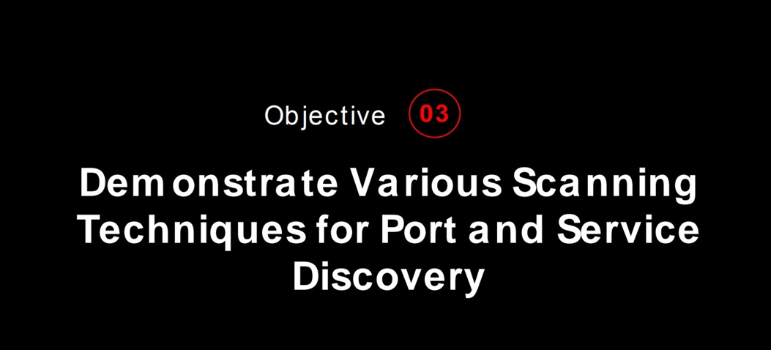
Jagannath University
17

Slide 17
What is Port and Service Discovery?
Port Discovery: Identifies open ports on a system that can communicate over the network.
Service Discovery: Determines the services and applications running on those open ports.
It helps security professionals map the network, detect vulnerabilities, and understand potential attack points.
Jagannath University
18

Slide 18
Port and Service Discovery Scanning Techniques
TCP Connect Scan
Establishes a full TCP connection to identify open ports and associated services.
SYN (Half‑Open) Scan
Sends partial TCP handshake requests to detect open ports without completing the connection.
UDP Scan
Sends UDP packets to discover open UDP ports and running services.
Jagannath University
19

Slide 19
Port and Service Discovery Scanning Techniques(Cont..)
Service Version Detection
Analyzes responses from open ports to determine the exact service and version running.
Banner Grabbing
Collects service banners to identify software type and configuration details.
Stealth Scanning
Uses modified packet techniques to reduce detection by security systems.
Jagannath University
20

Slide 20
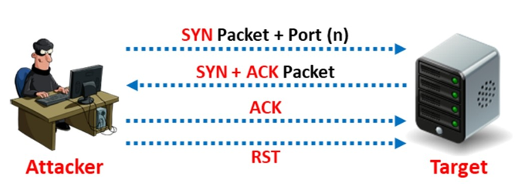
TCP Connect Scan
The scanner (attacker) sends a SYN packet to a specific port (n) on the target system
If the port is open:
The target replies with SYN + ACK
The scanner immediately sends RST (resets the connection)
This confirms the port is open without completing the full connection
FIGURE 3: Scan result when a port is open
Jagannath University
21

Slide 21
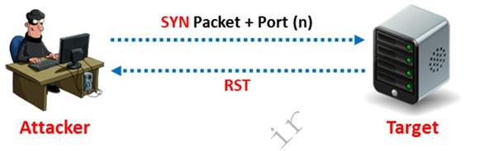
TCP Connect Scan(Cont..)
If the port is closed:
The target responds with an RST packet
This indicates the port is closed
If there is no response:
The port is considered filtered or blocked by a firewall
FIGURE 3: Scan result when a port is closed
Jagannath University
22

Slide 22
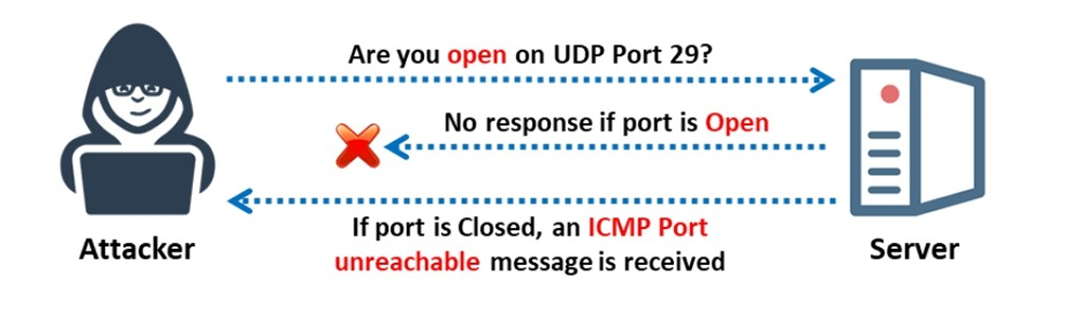
UDP(User datagram protocol) Scanning
UDP Raw ICMP Port Unreachable Scanning is a method used to identify open or closed UDP ports.
UDP packet is sent to a target port without a three-way handshake.
If the port is closed, the host replies with an ICMP Port Unreachable message.
If there is no response, the port is considered open or filtered by a firewall.
This makes UDP scanning slower and less certain compared to TCP scanning.
FIGURE 3: UDP Scaning
Jagannath University
23

Slide 23
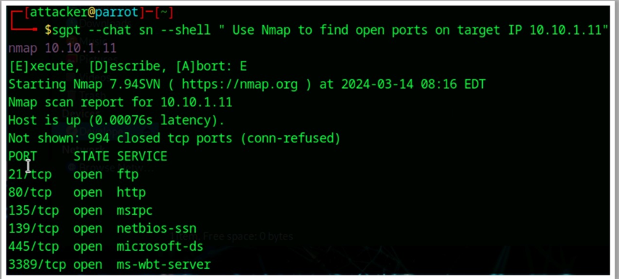
AI-Based Port Scanning
Using some ai command we can perform the port scanning operations. Some of them
Use nmap to find the open port on the target IP 10.10.1.11.
FIGURE 3: UDP Scaning
Jagannath University
24

Slide 24
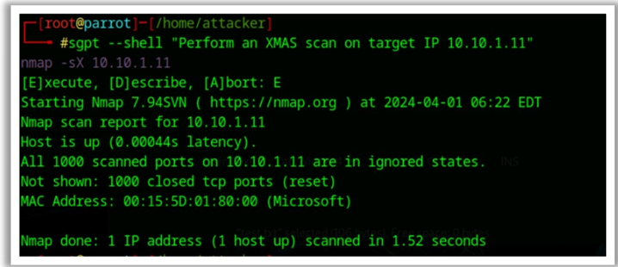
AI-Based Port Scanning
Perform an XMAS scan on the target IP 10.10.1.11.
FIGURE 3: perform XMAS scan on the target Ip
Jagannath University
25

Slide 25
Nmap Scan Time Reduction Techniques
Omit Non-Critical Tests
Skip unnecessary scans like version detection or OS detection
Focus only on required ports and services
✔ Reduces scan overhead
Upgrade Nmap
Use the latest Nmap version
Improved performance and bug fixes
✔ Faster and more accurate scans
Optimize Timing Parameters
Use faster timing templates (T3–T5)
Adjust retries and delays
✔ Speeds up packet transmission
Omit Non-Critical Tests
Skip unnecessary scans like version detection or OS detection
Focus only on required ports and services
✔ Reduces scan overhead
Jagannath University
26

Slide 26

Jagannath University
27

Slide 27
Banner Grabbing
Banner grabbing is the method used to determine the operating system running on a remote target system . There are two types of banner grabbing
Active Banner Grabbing
Attacker or tester directly connects to the target service (like HTTP, FTP, SSH) to request information.
Involves sending packets or commands and reading the response.
Example tools: Nmap, Netcat, Telnet
Passive Banner Grabbing
No direct interaction with the target occurs.
Information is gathered from network traffic, logs, or publicly available sources.
Example: Sniffing packets with Wireshark or analyzing search engines, Shodan
Jagannath University
28

Slide 28
OS discovery Nmap Script Engine
Nmap Script Engine (NSE)are used to gather additional information from services and network responses to improve OS detection accuracy.
Why is it Important?
Security Assessment: OS helps security testers identify vulnerabilities specific system.
Target Profiling: Helps attackers or defenders choose the right tools or exploits.
Network Management: Helps administrators know which devices are running which OS.
Accuracy: Using NSE scripts increases detection success when traditional OS detection is blocked or filtered.
Common NSE Scripts for OS Discovery
smb-os-discovery : Detects Windows OS via SMB service
http-headers : Reveals OS info from web server HTTP headers
Jagannath University
29

Slide 29
OS Discovery Using IPv6 Fingerprinting
OS discovery using IPv6 fingerprinting is the process of identifying a target system’s operating system by analyzing how it implements and responds to IPv6 network protocols.
Nmap uses a separate IPv6-specific OS detection engine and sends nearly 18 probes to identify the target OS.
Probes sent in the following order:
Sequence Generation (S1–S6)
ICMPv6 Echo (IE1)
ICMPv6 Echo (IE2)
Node Information Query (NI)
Neighbor Solicitation (NS)
UDP Probe (U1)
TCP Explicit Congestion Notification (TECN)
TCP Probes (T2–T7)
Syntax:nmap -6 -O target_ipv6
Jagannath University
30

Slide 30

Jagannath University
31

Slide 31
Scanning Beyond IDS and firewall
Attackers and security testers use the following techniques to evade IDS/IPS and firewalls during scanning:
Packet Fragmentation
Source Port Manipulation
Source routing
IP address spoofing
IP address decoy
Mac address spoofing
Proxy servers
FIGURE 3: perform XMAS scan on the target Ip
Jagannath University
32

Slide 32
IP Address Spoofing
IP address spoofing is the process of creating Internet Protocol (IP) packets with a false or forged source IP address to disguise the sender's identity or impersonate a legitimate computer system.
It operates at the Network Layer (Layer 3) of the OSI model and is commonly used to hide the attacker’s identity or impersonate another device.
In normal communication, each IP packet contains a source IP and a destination IP.
Attacker modifies the source IP address before sending the packet, so the receiver believes the packet came from a different system.
Jagannath University
33

Slide 33
Mac Address Spoofing
MAC address spoofing is a technique in which an attacker changes or forges the Media Access Control (MAC) address of a network interface to impersonate another device on the same local network.
It works at the Data Link Layer (Layer 2) of the OSI model.
Every network device has a unique MAC address assigned by the manufacturer.
Attacker manually alters this address using software tools, making the device appear as a trusted system on the network.
Jagannath University
34

Slide 34
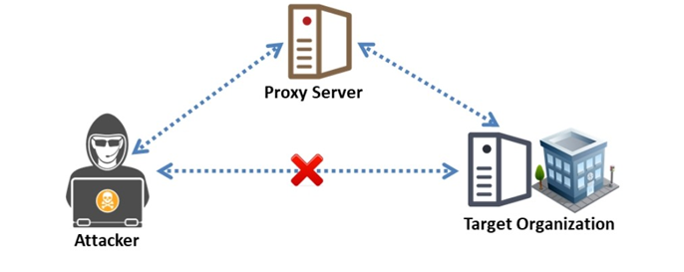
Proxy server
A proxy server is an intermediary server that sits between a client (user) and the internet (or another server). It forwards client requests to the destination server and then sends the response back to the client.
It acts as a gateway or middleman between a user and the web.
How a Proxy Server Works
A client (like your browser) sends a request for a website or resource.
The request goes to the proxy server first.
The proxy server forwards the request to the destination server.
The destination server responds to the proxy server.
The proxy server sends the response back to the client.
FIGURE 3:attacker use proxy sever to connecting the target server
Jagannath University
35

Slide 35
Proxy server(cont..)
A proxy server is used to perform several important functions in networking:
Hiding IP Address / Anonymity
  The proxy hides your real IP address from the websites you visit.
  Helps protect your privacy online.
Bypassing Restrictions / Firewalls
  Access blocked websites or content restricted by region.
  Useful for bypassing company or school network restrictions.
Improving Security
  Can filter out malicious websites or dangerous content.
  Prevents direct access between clients and the internet.
Caching / Speed Improvement
  Stores frequently accessed web pages or resources.
  Reduces load time and saves bandwidth.
Monitoring / Access Control
  Organizations can monitor employee internet usage.
  Blocks access to unwanted or harmful websites.
Jagannath University
36

Slide 36
Thank You

